Slide 1

AGRIINTELLIGENCE: AN EXPLAINABLE AI-BASED AGRICULTURAL DECISION SUPPORT SYSTEM
Final Project Review | Dept. of CSE | KLH Deemed to be University, Bowrampet
TEAM MEMBERS
2420030401 – MEGHNA
2420030442 – THANUSREE
2420030117 – RASAGNA
Guide: Dr N Sunanda, Assosiate Professor | Academic Year: 2026–27

Slide 2



Introduction & Problem Statement
Background
THE INFORMATION GAP
Farmers make high-stakes crop decisions with fragmented information. Unpredictable weather and volatile market prices often cause financial losses.
Crop / Soil
Weather
Problem Statement
Market Prices
Existing systems treat crop, weather and market data in isolation, at different intervals. Farmers need one adaptive system.
Three data sources, collected at different intervals and analysed in isolation.
Which crop is suitable and economically promising under current conditions?
Motivation / Need
Farmers, agricultural experts and policy makers. Without unified intelligence, crops are chosen without visibility into both suitability and profitability.

Slide 3


Objectives & Scope
Objectives
In scope
1
Integrate crop/soil, weather and market-price data into one system, aligning datasets collected at different intervals.
Crop-yield prediction with crop, location, season, area and weather features
Weather-aware versus baseline model comparison
Design of the full pipeline, price module and farmer dashboard
2
Predict suitable crops and yield from soil and environmental conditions, and analyse how weather influences them.
3
Forecast market-price trends to support economically profitable crop selection.
Out of scope (current phase)
Nationwide weather-aware validation and deployment
News and policy event analysis
Post-harvest storage and logistics
4
Deliver clear, explainable recommendations through a farmer-friendly dashboard.

Slide 4

Literature Survey
S.No | Study / Research Area | Data & Method | Key Findings | Limitation / Gap
1 | Crop Yield Prediction (ML) | Crop/soil + weather data; Random Forest, Gradient Boosting, Deep Learning | Strong yield prediction performance | Focuses mainly on yield, not economics
2 | Agricultural Price Prediction | Historical prices + weather/market variables; Regression, XGBoost, time series | Weather and market data improve price forecasts | Lacks detailed crop suitability integration
3 | Multi-Modal Agricultural Prediction | Crop/yield + remote sensing + weather + market; Ensemble / Deep Learning | Connects productivity and market information | Data synchronization and regional generalization remain challenging
Research Gap
Existing work treats yield, price and weather separately, and struggles to align data collected at different rates or to generalise across regions. AgriIntelligence integrates all three sources (Objectives 1–4).

Slide 5





Proposed System & Methodology
STEP 1
STEP 2
STEP 3
STEP 4
STEP 5
Define Problem
Collect Data
Design
Implement
Test & Evaluate
Farmers lack unified crop, weather and market guidance.
115 crops, 34 states/UTs, 737 districts (455,359 records, 1997–2022) plus Open-Meteo weather.
CatBoost regression on log-yield with chronological splits.
Clean data, merge weather, train baseline and weather-aware models.
MAE, RMSE and R² on later-year test data.
Key Novelty / Contribution
Instead of “Which crop can grow?”, AgriIntelligence asks which crop is suitable and economically promising, by joining crop/soil, weather and market data in one explainable system.

Slide 6
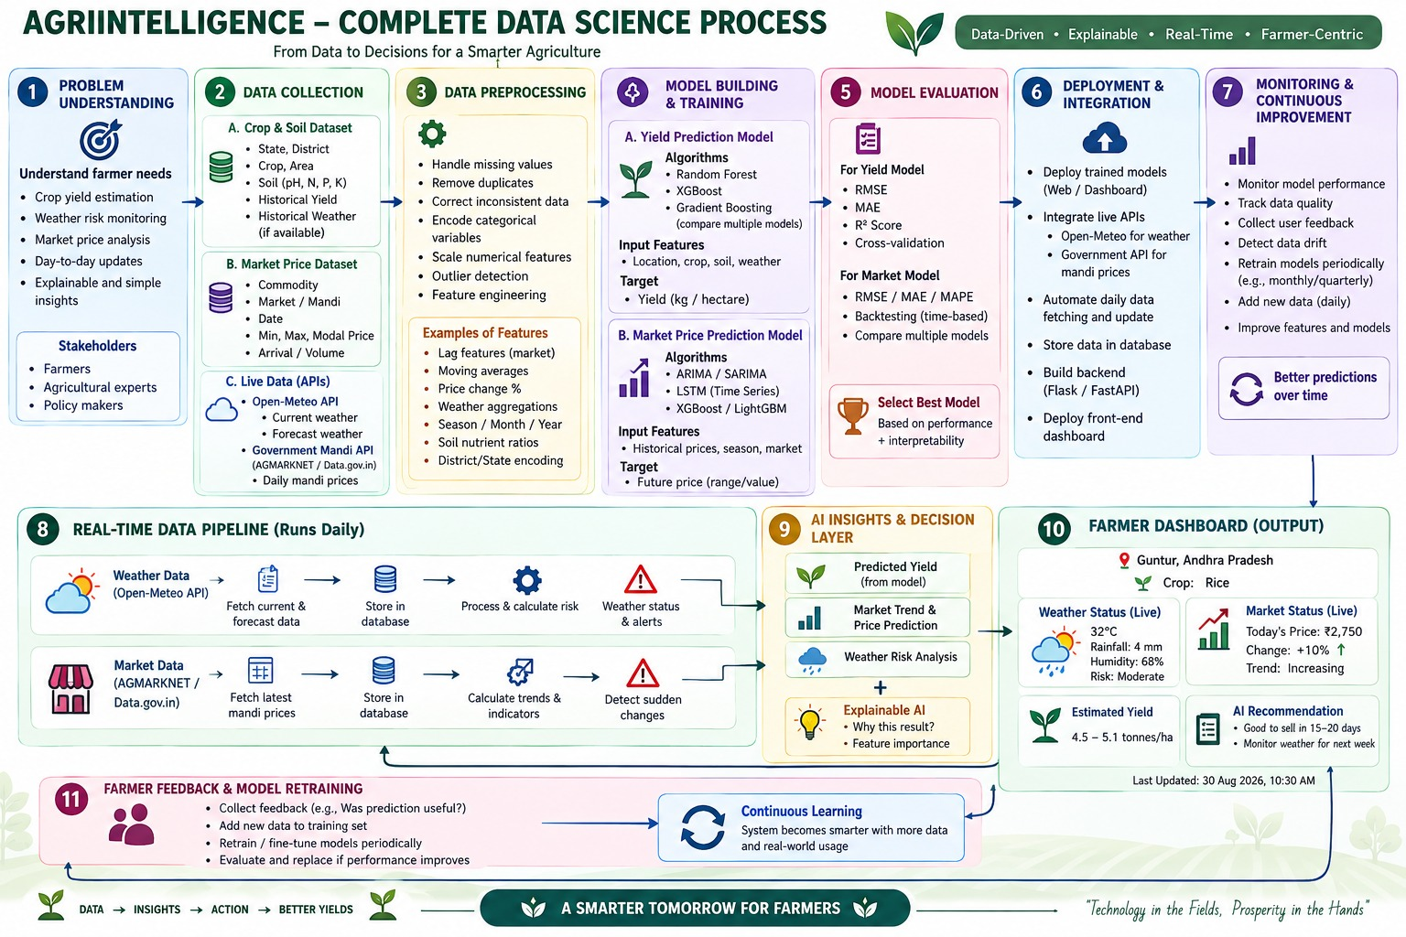
System Architecture
Components
1
Data Layer
Crop/soil, weather and market inputs
2
Preprocessing
Cleaning, encoding, alignment, features
3
Prediction Models
CatBoost yield; price forecasting planned
4
Insights & Dashboard
Explainable advice for farmers

Slide 7


Hardware & Software Requirements
Hardware
Software & Tools
Libraries / Frameworks
No specialised hardware needed
Standard laptop / PC with a browser
Google Drive for storage
Internet access for weather API calls
Python
Google Colab notebooks
Google Drive (data and model files)
Planned: Flask / FastAPI backend
Pandas, Scikit-learn
CatBoost (model saved as .cbm)
Open-Meteo Archive API
Planned: PostgreSQL / Firebase
Deployment / Platform: Google Colab (prototype); web dashboard with REST APIs planned

Slide 8
Dataset / Data Understanding
Attribute | Type | Role
Year | Numeric | Feature / split key
State | Categorical | Feature
District | Categorical | Feature
Crop | Categorical | Feature
Crop type | Categorical | Feature
Season | Categorical | Feature
Area | Numeric | Feature
Yield | Numeric | Target
455,359
8
Records (rows)
Features (columns)
9,038
1
Zero-yield rows
Regression target
Source: Compiled historical Indian agricultural CSV datasets (original source URLs to be documented).
Features: Year, state, district, crop, crop type, season and area; target: yield.
Coverage: 1997–2022; 34 states/UTs, 737 districts and 115 crops. 9,038 zero-yield records were identified for review.
Dataset profile
455,359 records • 7 input features • 1 yield target
34 states/UTs • 737 districts • 115 crops

Slide 9



Data Preprocessing & Exploratory Analysis
Data pipeline: raw records to model-ready data
1. Clean records and remove inconsistencies
2. Extract the agricultural year
3. Handle state, district, crop and season as categorical features
4. Merge Open-Meteo temperature and rainfall
5. Log-transform yield; split chronologically
Aligning data collected at different rates
Crop / yield: seasonal records give the reference timeline
Weather: daily records aligned to each record’s year and location
Market prices (planned): lags and moving averages onto the same timeline
Yield is right-skewed, so the target is log-transformed
Cleaning
Transformation
Feature Selection
Cleaned the dataset; 9,038 zero-yield rows flagged for review.
Agricultural year extracted; categorical features handled; yield log-transformed.
7 inputs: year, state, district, crop, crop type, season, area (+ weather in Nalgonda).

Slide 10
Module-wise Description
1
Data Collection & Preprocessing
2
Weather Integration
Purpose: Collect and clean crop records; extract agricultural year
Input → Output: Raw CSV (455,359 records) → clean dataset
Developed by: [Member – to confirm]
Purpose: Retrieve temperature and rainfall and align them to crop records
Input → Output: Location + year → weather features
Developed by: [Member – to confirm]
3
Yield Prediction Model
4
Decision Support & Dashboard (planned)
Purpose: Train baseline and weather-aware CatBoost models
Input → Output: Features → predicted yield (.cbm, CSV)
Developed by: [Member – to confirm]
Purpose: Combine yield, price trend and weather risk into advice
Input → Output: Predictions + live data → recommendations
Developed by: [Member – to confirm]

Slide 11

Algorithms & Technologies Used
CatBoost Regressor
Log Transformation
Chronological Split
Why chosen
Handles categorical features natively and fits tabular data well.
Key parameters
Categorical: state, district, crop, season; target: log(yield); saved as .cbm
Why chosen
Reduces the influence of highly skewed yield values.
Key parameters
Applied to the yield target only
Why chosen
Mimics real forecasting: learn from past years, predict later ones.
Key parameters
Train 1997–2019, validate 2020–21, test 2022 (Nalgonda comparison: 2021–22)
Selection criteria: MAE, RMSE and R² on later-year data; models with and without weather compared

Slide 12
Implementation / Model Building
Feature Selection
Code snippet / pseudocode
Year, state, district, crop, crop type, season, area (weather added in the Nalgonda experiment)
# Pseudocode: weather-aware yield model
df = load("crop-wise-area-production-yield.csv")
df["year"] = extract_agricultural_year(df)
df = merge_weather(df, open_meteo_archive)
y = log(df["yield"])
train, val, test = split_by_year(df)
model = CatBoostRegressor(cat_features=[
"state", "district", "crop", "season"])
model.fit(train, y_train, eval_set=val)
model.save_model("yield_model.cbm")
Preprocessing Pipeline
Clean → extract year → handle categories → merge weather → log(yield)
Data Splitting
Chronological: train 1997–2019, validation 2020–2021, test 2022
Configuration
CatBoost regression, log-yield target; model saved as .cbm

Slide 13
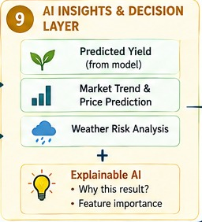
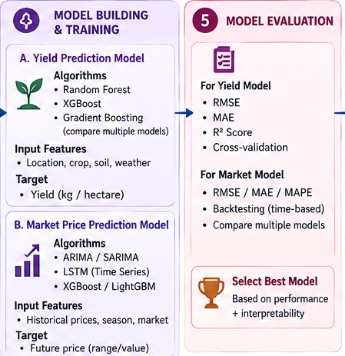
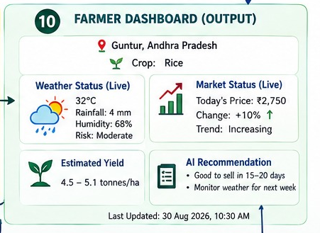
Prototype Outputs & Dashboard Design
Farmer dashboard (design)
Live weather, price, yield range and advice
AI insights layer (design)
Yield, price trend, weather risk, explanation
Model plan (design)
Yield and price models with evaluation metrics

Slide 14
Results & Performance Comparison
Metric | Nalgonda Baseline | Nalgonda Weather-aware | Nationwide Baseline
MAE | 3.566 | 3.287 | 34.684
RMSE | 12.641 | 12.008 | 564.303
R² | 0.400 | 0.459 | 0.721
Test period | 2021–22 | 2021–22 | 2022
Evaluation scope | Nalgonda (80 test records) | Nalgonda (80 test records) | India-wide test split
Best: Weather-aware Nalgonda model – MAE 3.287 (vs 3.566 baseline)
Note: Nalgonda and nationwide results use different evaluation scopes; compare the two Nalgonda models directly, not against the nationwide scores.

Slide 15
Analysis & Key Findings
Nalgonda test comparison: R² (higher is better)
0.459
Baseline 0.400
R² achieved by weather-aware Nalgonda model
Weather-aware 0.459
Error in tonnes per hectare (lower is better)
Interpretation: Weather-aware experiment improved all three reported metrics on the same Nalgonda test subset.
Error analysis: Regional experiment has 705 crop records and 80 test records; results need broader validation.
Key inputs: Crop, district, season, area and weather variables in the regional experiment.
MAE baseline 3.566
MAE weather-aware 3.287
RMSE baseline 12.641
RMSE weather-aware 12.008
Navy = baseline, teal = weather-aware (same 80 Nalgonda test records)

Slide 16

Testing & Validation
Test ID | Test Description | Expected Result | Actual Result | Status
TC-01 | Chronological split | Test year follows training years | Train 1997–2019, validation 2020–21, test 2022 | Done
TC-02 | Weather retrieval | Open-Meteo history retrieved for Nalgonda | Retrieved and merged for the regional experiment | Done
TC-03 | Metric computation | MAE, RMSE and R² reported | Nationwide R² 0.721; Nalgonda weather-aware R² 0.459 | Done
TC-04 | Nationwide weather coverage | Weather features for all districts | Coverage remains in progress | In progress
Functional Testing
Validation Method
Performance Testing
Model training and prediction pipeline executed; saved model loaded for inference.
Chronological hold-out: train 1997–2019, validation 2020–2021, test 2022. Separate Nalgonda regional comparison.
MAE, RMSE and R² calculated for test data. Open-Meteo historical retrieval tested for Nalgonda. Nationwide weather coverage remains in progress.

Slide 17


Challenges & Limitations
Challenges Faced
Limitations
Multi-rate data → aligned to the agricultural year
Skewed yields and 9,038 zero-yield rows → log target, rows flagged
Many categorical fields → CatBoost native handling
Weather-aware results cover Nalgonda only (80 test records)
Nationwide weather coverage, market model and dashboard not done yet
Soil data and post-harvest factors not modelled

Slide 18

Conclusion
Built a nationwide CatBoost crop-yield model using 455,359 historical records across 34 states/UTs and 737 districts.
1
Final Outcome
Nationwide test R² = 0.721. In the Nalgonda experiment, weather integration improved MAE from 3.566 to 3.287.
0.721
2
Nationwide yield model + Nalgonda weather proof of concept
Nationwide weather expansion and market integration are in progress
The project establishes a working yield-prediction pipeline and a regional historical-weather proof of concept; nationwide weather and market integration are ongoing.
3

Slide 19



Future Scope & Applications
Improve Performance
Tune CatBoost; compare with XGBoost and Random Forest
Applications
Crop planning for farmers
Sell-timing advice from price trends
Regional planning for agricultural officers
Policy makers and agri-experts
Expand Data / Features
Add soil data, market prices and more regions
Deploy & Build an Interface
Farmer dashboard with Flask / FastAPI APIs
Scale & Secure
Daily live pipeline, monitoring and retraining

Slide 20
Team Contribution
Reg. No. | Name | Contribution / Modules Handled
2420030401 | Meghna | [Modules, tasks and report sections – to confirm]
2420030442 | Thanusree | [Modules, tasks and report sections – to confirm]
2420030117 | Rasagna | [Modules, tasks and report sections – to confirm]

Slide 21

References
[1] L. Prokhorenkova, G. Gusev, A. Vorobev, A. V. Dorogush and A. Gulin, “CatBoost: Unbiased boosting with categorical features,” in Proc. NeurIPS, 2018, pp. 6638–6648.
[2] P. Zippenfenig, “Open-Meteo.com Weather API,” Zenodo, 2023. doi: 10.5281/zenodo.7970649.
[3] Directorate of Marketing & Inspection, Govt. of India, “AGMARKNET: Agricultural Marketing Information Network.” [Online]. Available: https://agmarknet.gov.in
[4] “Crop-wise area, production and yield dataset” (crop-wise-area-production-yield.csv). Source details to be added.
[5] Literature survey papers (crop yield, price and multi-modal prediction) to be added.
Project Links
GitHub: [to be added]
Dataset: [to be added]
Demo video: [to be added]

Slide 22
THANK YOU
Questions & Discussion
Team: Meghna, Thanusree, Rasagna
Guide: Dr N Sunanda, Dept. of CSE, KLH Bowrampet Campus

